Slide 1

One Nation, Two Maps SDG Accountability in India
Same data, different stories—decoding India's development dilemma
Ref: https://sdgindiaindex.niti.gov.in/#/
- Budha Sree Mandapaka

Slide 2
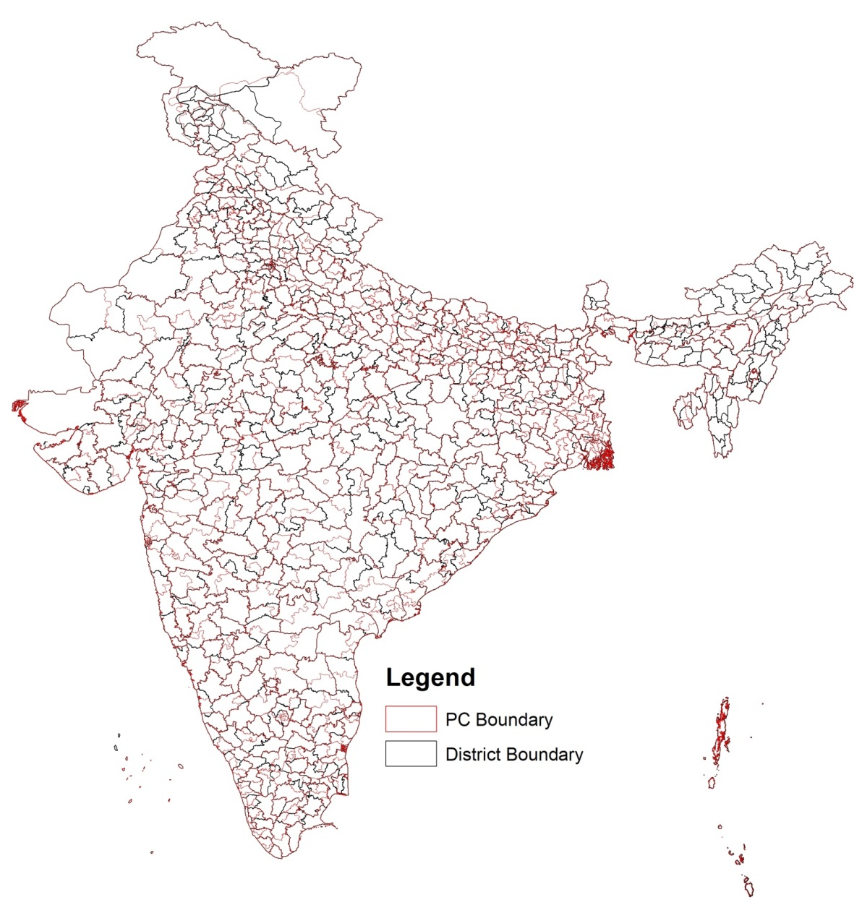
Administrative(District) Unit
vs.
Political (PC) Unit
In India, there is a fundamental disconnection between the administrative unit (i.e., 785 districts) at which data on key developmental indicators are available and the political unit (i.e., 543 parliamentary constituencies [PC]) at which political actions take place.
The discussion and decision around policies and programmes concerning health, education, and livelihoods are largely driven by data at the district level. However, there are no political representatives directly accountable for the performance at this administrative level.
Whereas Members of Parliament (MPs) in the Lok Sabha (Lower House of the Indian Parliament), each representing 543 PCs as per the 2014 India map are accountable for the vision and implementation of public policies at the national and the specific constituency level.
Hence, it is critical to produce the most accurate and up-to-date evidence on the state of health and wellbeing at the PC-level for MPs to efficiently and effectively serve their people, and for the constituents to understand the performance of their MPs for re-election.
Ref: https://doi.org/10.1016/j.ssmph.2019.100375
Ref: https://ars.els-cdn.com/content/image/1-s2.0-S2352827318303732-mmc1.docx

Slide 3
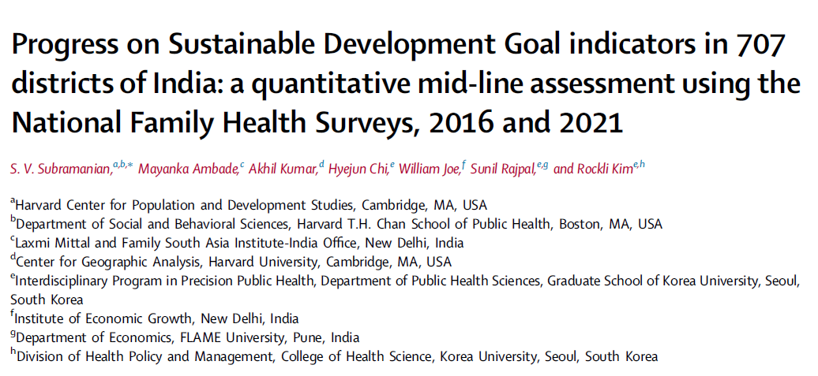
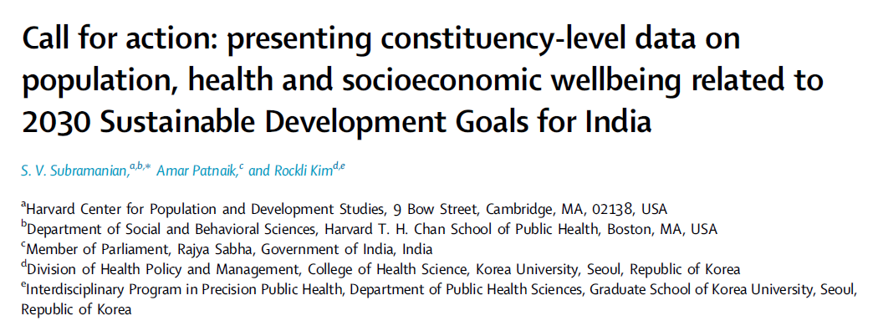
Administrative(District) vs. Political (PC) Lens on SDG Indicators
This research initiative aims to compare SDG indicators in selected districts (707) against their parliamentary constituencies (543) to highlight how the lack of alignment in data boundaries leads to inconsistent accountability. Most importantly empower MPs to identify focal points within their constituencies to drive their policy decisions.
Lancet’s Study on SDG 2030 – India as per NFHS5(2019-21) who presented district-level and constituency-level data is utilised along with their Geographic Insights at Harvard University.
Due to the absence of PC identifiers in nationally representative surveys and lack of hierarchical structure where PCs perfectly nest within districts, two methodologies were developed by S. V. Subramanian(2019) to enable PC-level estimations from the NFHS data(district-level) and is proven with empirical evidence.
https://doi.org/10.1016/j.lansea.2023.100155
https://doi.org/10.1016/j.lansea.2024.100358

Slide 4








Administrative(District) vs. Political (PC) Lens on
9 SDGs, 12 Indicators
Access to Basic Services
Stunting in Children
Wasting and Overweight in Children
Anaemia (Women)
Teenage Pregnancy
( 15 to 19 )
Tobacco Use (Men)
Partner Violence
(Physical or Sexual)
Child Marriage Girl ( <15 )
Improved Water
Clean Fuel for Cooking
Bank Account for Women
Teenage Sexual Violence
Ref: https://knowsdgs.jrc.ec.europa.eu/

Slide 5
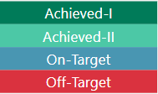
Administrative(District) vs. Political (PC) Lens on
9 SDGs, 12 Indicators
Metadata
SDG Status
Source Fields
Achieved: These constitute districts/PCs that have already met the SDG target by 2021. The Achieved status can be categorized into two types:
Achieved-I: districts/PCs that have already met the SDG target by 2021 and have either observed an improvement between 2016 and 2021 or a worsening small enough in magnitude between 2016 and 2021 such that they will still maintain their Achieved status by 2030.
Achieved-II: districts/PCs that have already met the SDG target by 2021 but have observed a worsening magnitude of change between 2016 and 2021. If this trend continues, the status of these districts as Achieved will be undone by 2030.
On-Target: These constitute districts/PCs that have not met the SDG target by 2021 and have observed a magnitude of improvement between 2016 and 2021 sufficient to meet the target by 2030.
Off-Target: These constitute districts/PCs that have not met the SDG target by 2021 and either observed worsening
between 2016 and 2021 or observed an insufficient magnitude of improvement between 2016 and 2021. If these districts/PCs continue with either of these trends, they will not meet their targets by 2030.
State ABV: State Name Abbreviation (28 States & 8 Union Territories)
AAC: Annual Absolute Change for each indicator
NFHS5: National Family Health Survey Projection as of 2021
NFHS4: National Family Health Survey Projection as of 2016

Slide 6

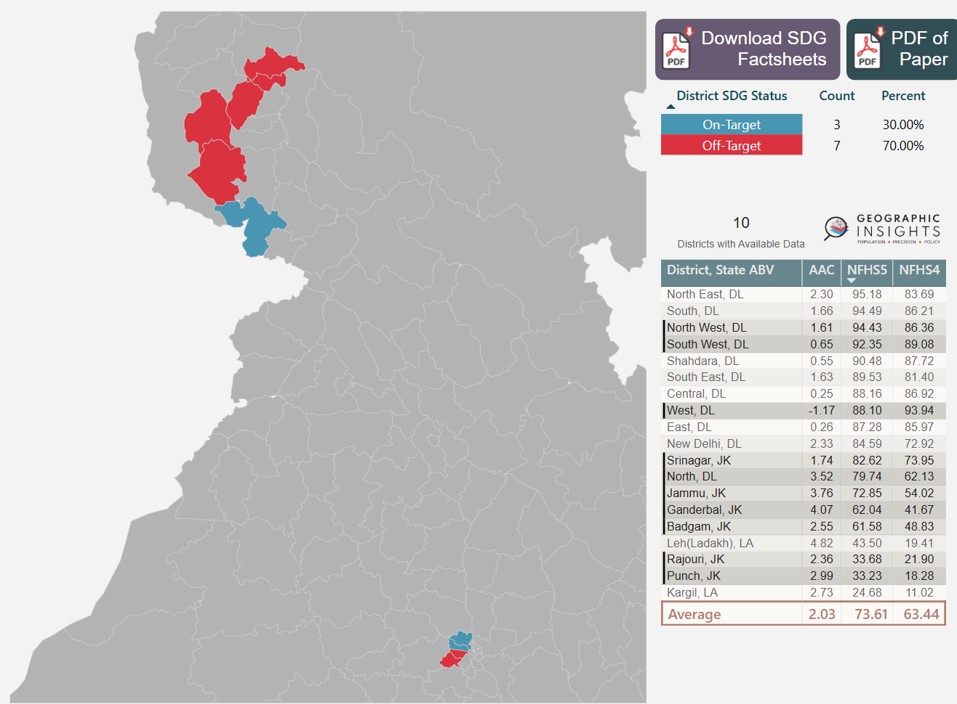
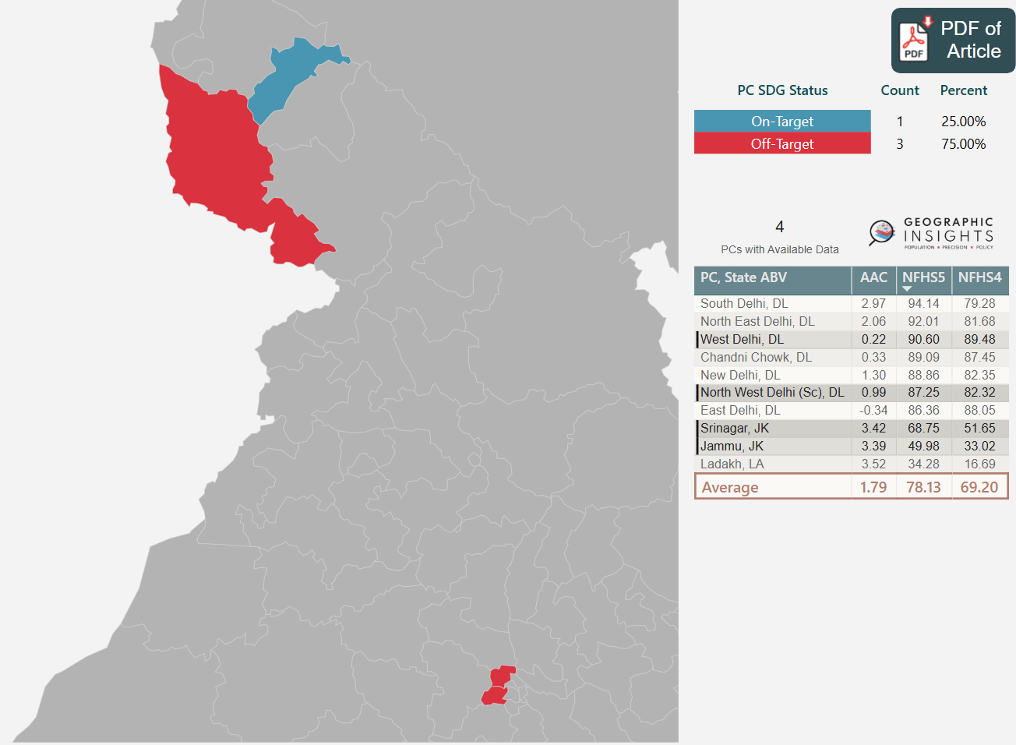
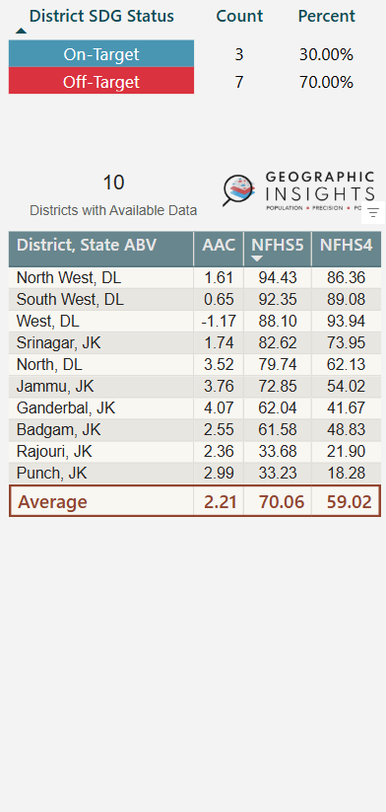
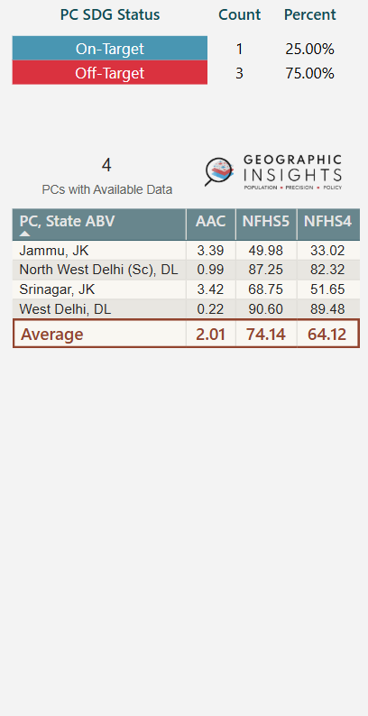
Access to Basic Services
Jammu constituency has to focus on access to basic services within Rajouri and Punch districts.
Even though Srinagar constituency looks on-target, it has to make sure performance of individual districts (Srinagar, Badgam and Ganderbal) doesn’t go off-target.
North West Delhi constituency might need further investigation as it appears on-target at district-level.
Administrative Lens
Political Lens
Ganderbal
A
Badgam
Srinagar
Srinagar
B
Punch
C
Rajouri
Jammu
Jammu
Data is not available for Claimed territories:
Gilgit
Ladakh (Baltistan)
Gilgit Wazarat
North
North West Delhi (Sc)
North West
West
South West
West Delhi
Notes:
Data is not available for Claimed territories: A. Gilgit B. Ladakh (Baltistan) C. Gilgit Wazarat

Slide 7
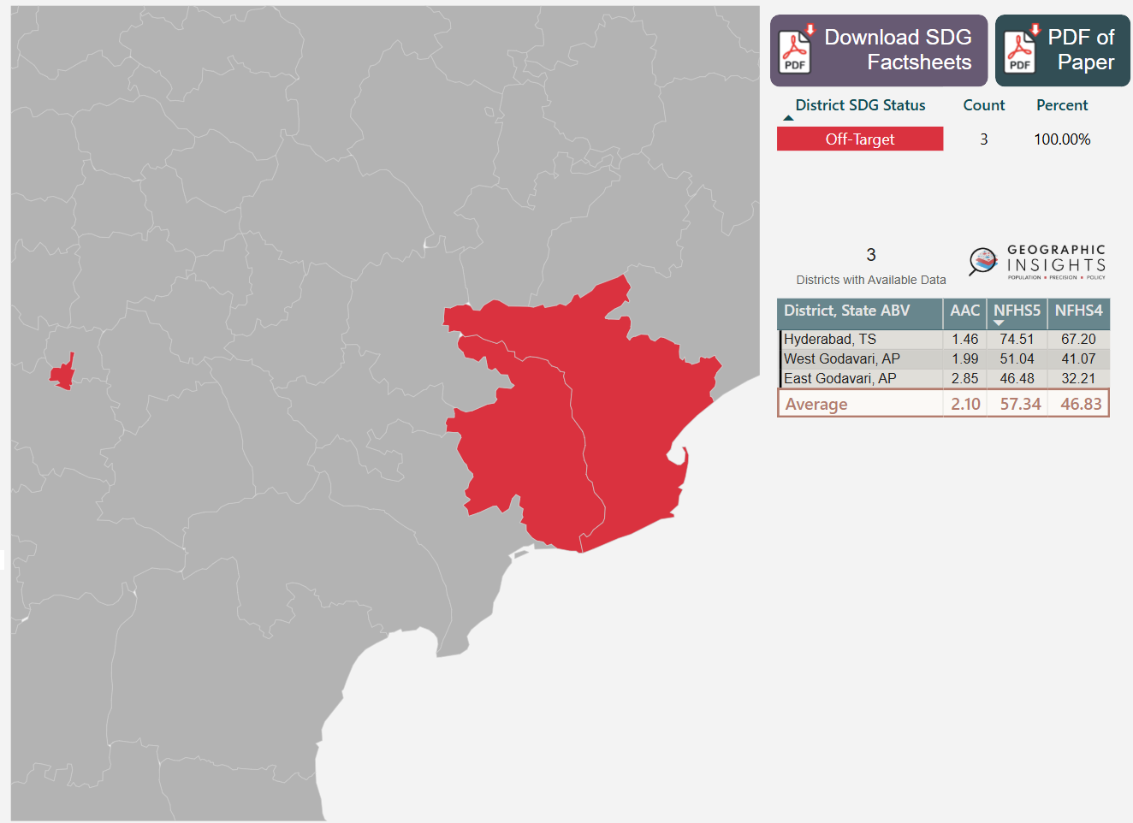
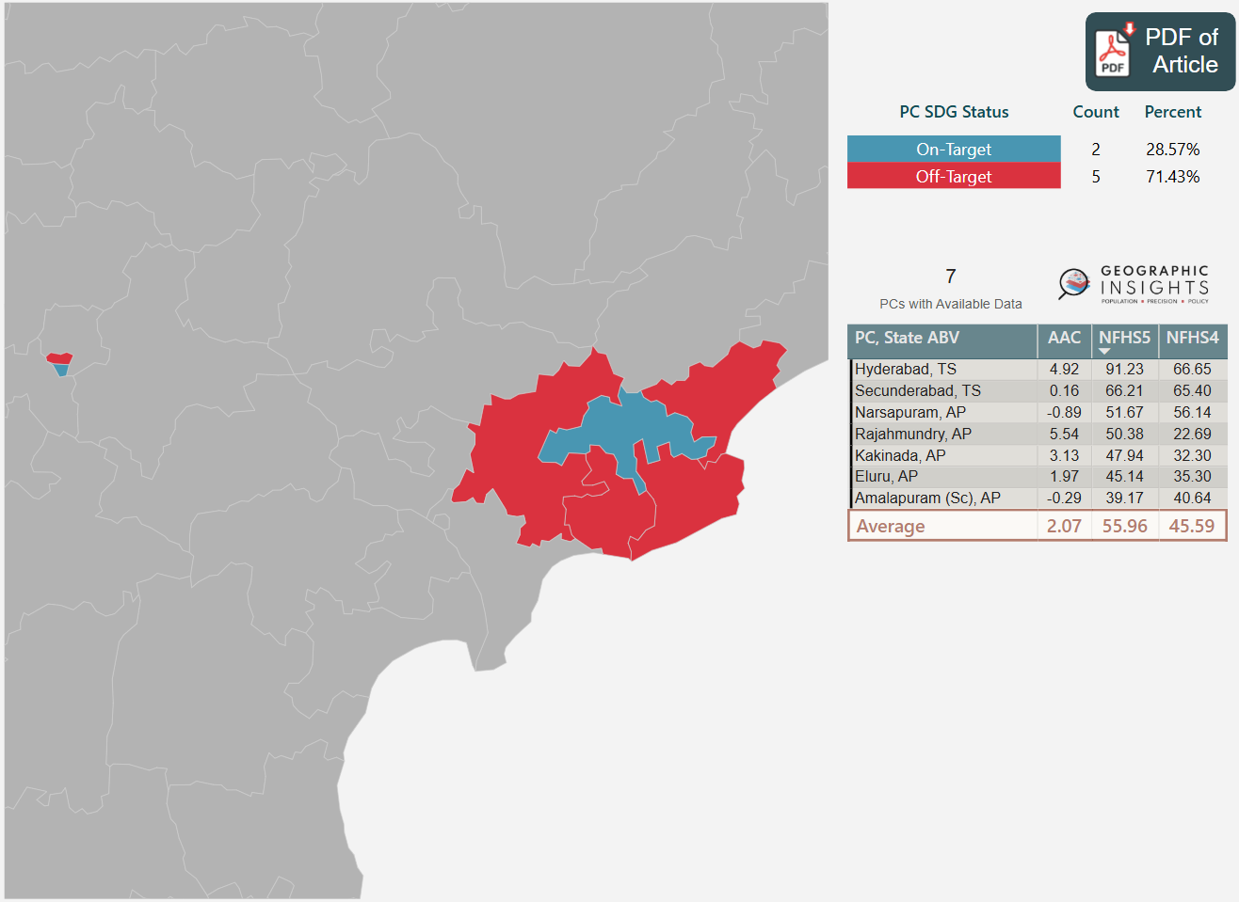
Access to Basic Services
Secunderabad constituency still got work to do. Hyderabad and Rajahmundry are on-target.
Burden of West & East Godavari districts can be distributed among Narsapuram, Kakinada, Eluru and Amalapuram constituencies and make regional policy decisions to reach on-target.
Administrative Lens
Political Lens
East Godavari
Secunderabad
Kakinada
Hyderabad
Eluru
Hyderabad
Rajahmundry
Narsapuram
Amalapuram (Sc)
West Godavari

Slide 8

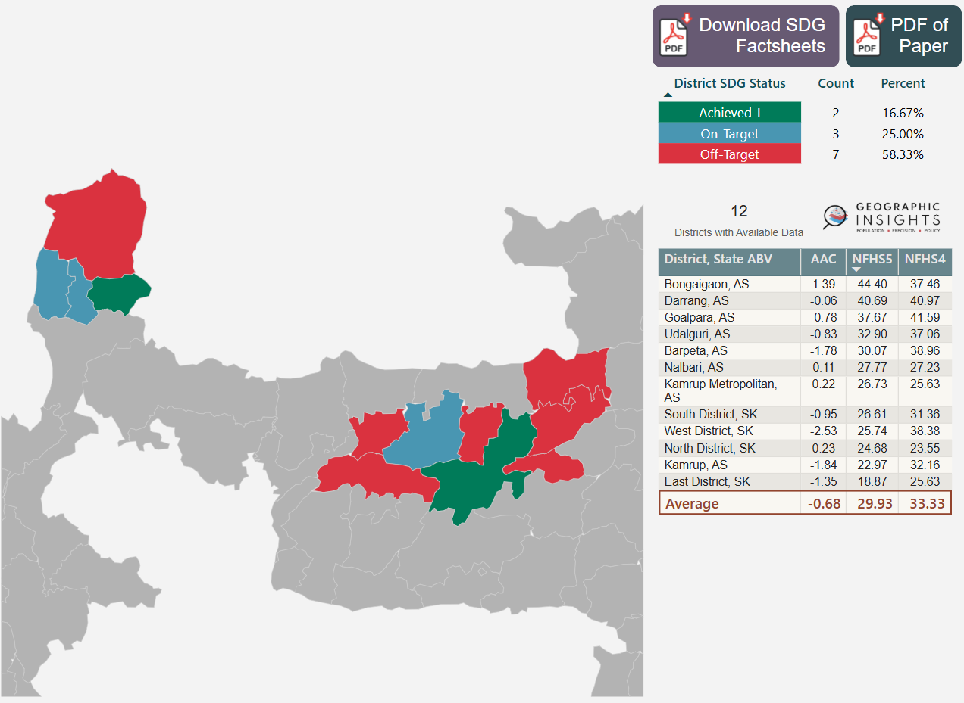
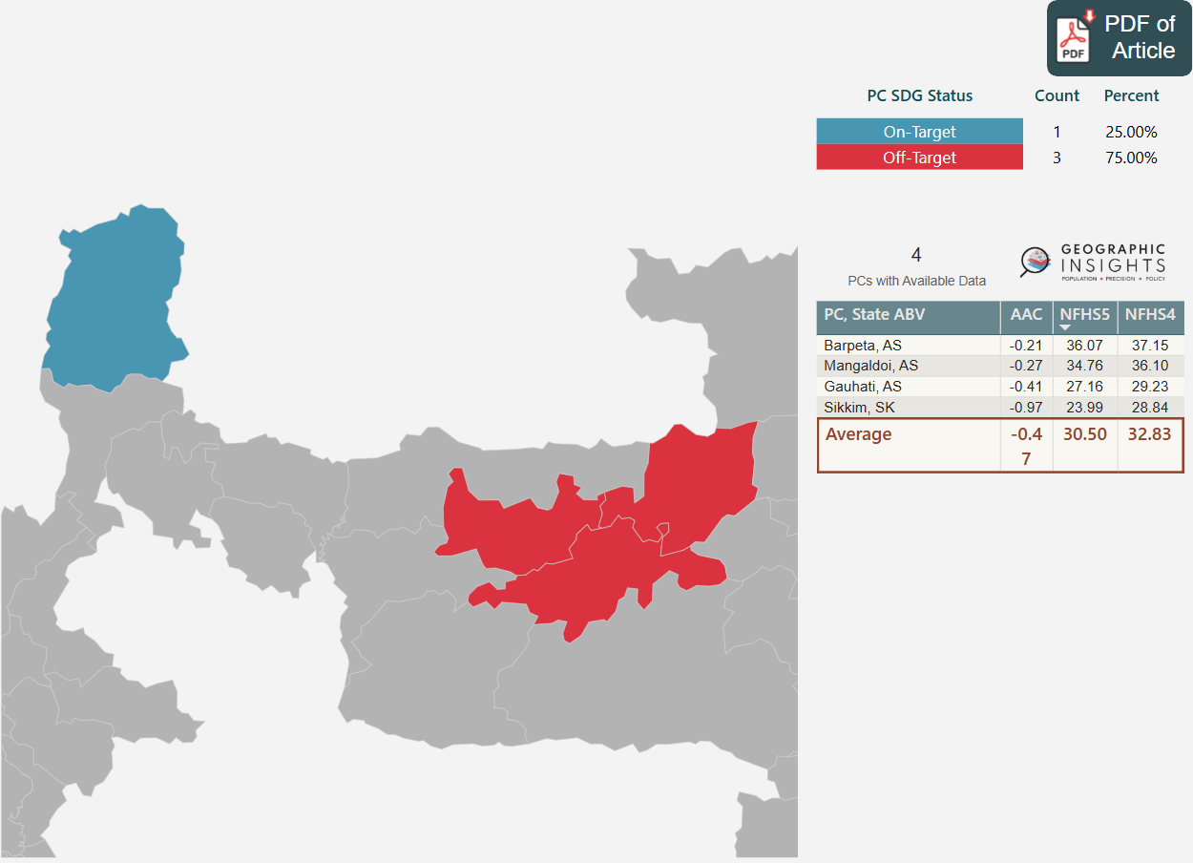
Stunting in Children
Sikkim constituency has to focus on child mal-nutrition in North district.
Although Kamrup district achieved the target, Gauhati constituency has to prioritise child nutrition in Kamrup Metropolitan, Goalpara and Darrang regions too.
Administrative Lens
Political Lens
North District
Sikkim
West
District
East District
South District
Udalguri
Mangaldoi
Bongaigaon
Nalbari
Barpeta
Barpeta
Darrang
Goalpara
Kamrup
Metropolitan
Gauhati
Kamrup

Slide 9
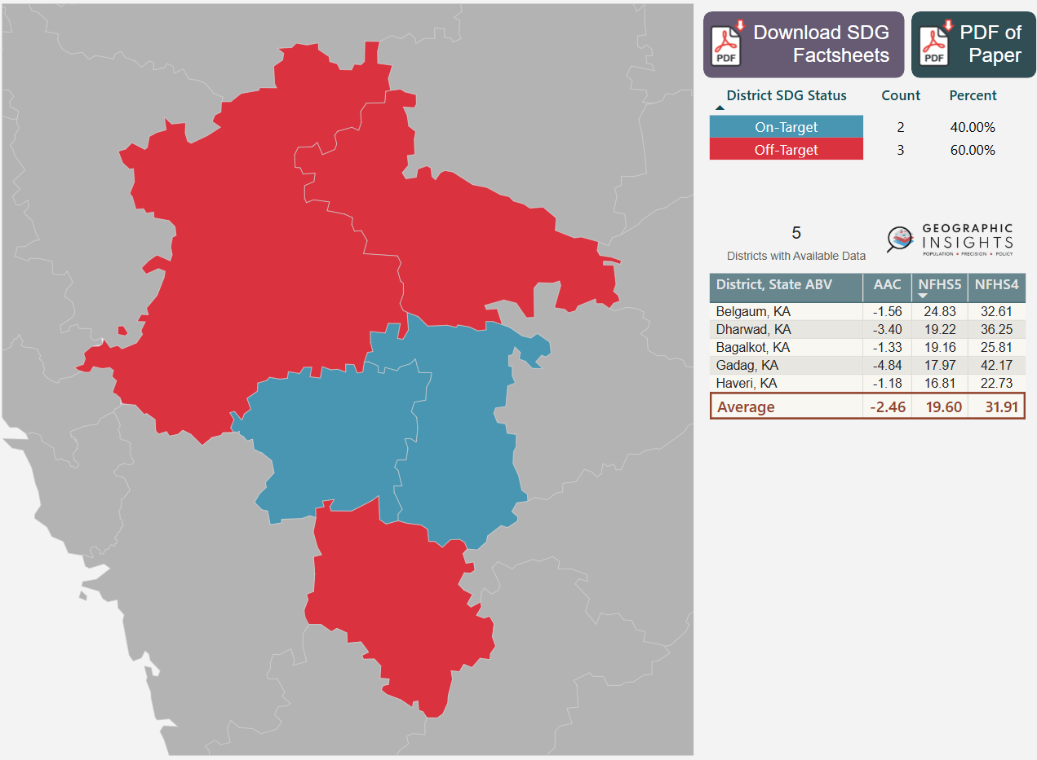
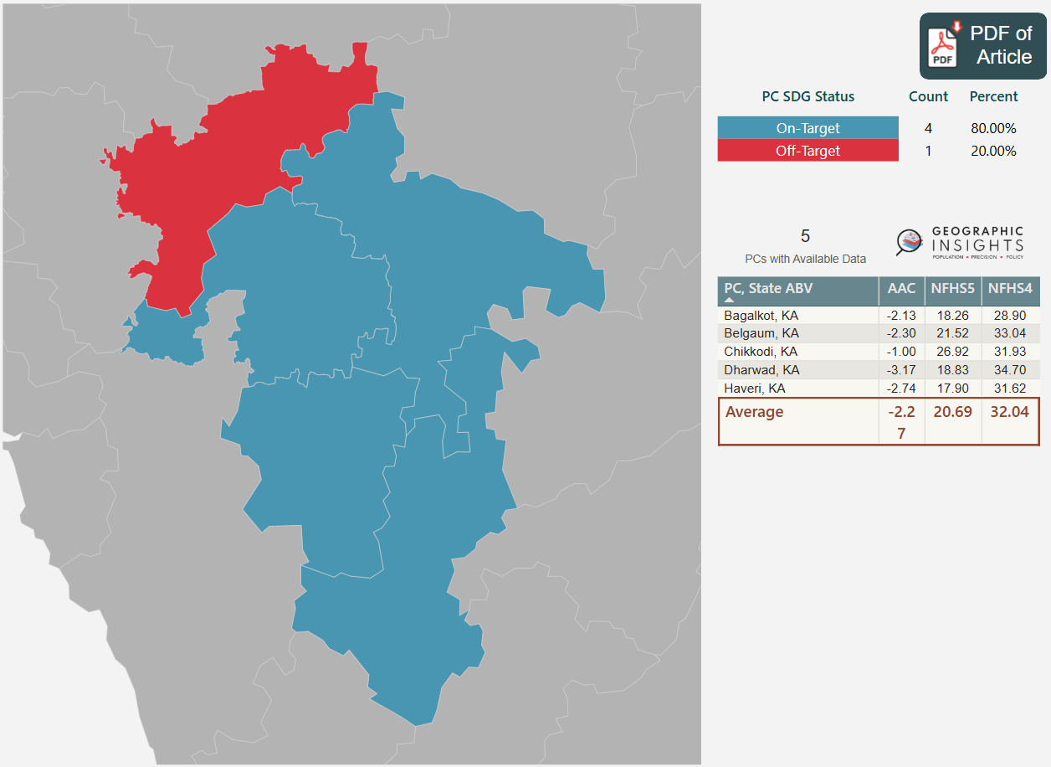
Wasting and Overweight in Children
Chikkodi constituency can find insights from the on-target progress of Belgaum region to minimise wasting in children.
Southern region of Haveri and Northen region of Bagalkot still need policy tweaks.
Administrative Lens
Political Lens
Chikkodi
Bagalkot
Bagalkot
Belgaum
Belgaum
Gadag
Dharwad
Dharwad
Haveri
Haveri

Slide 10
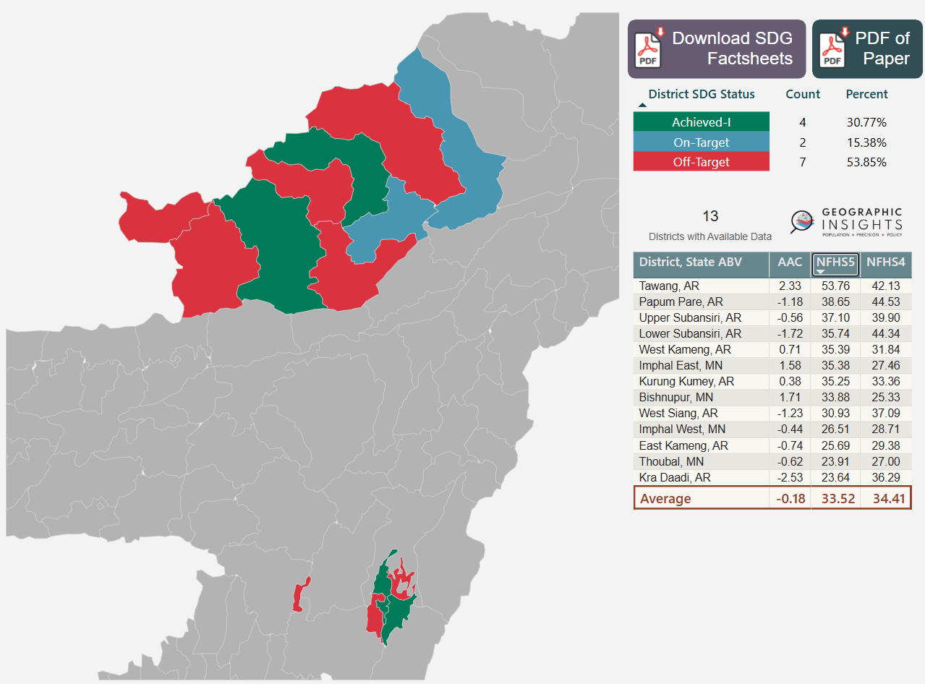
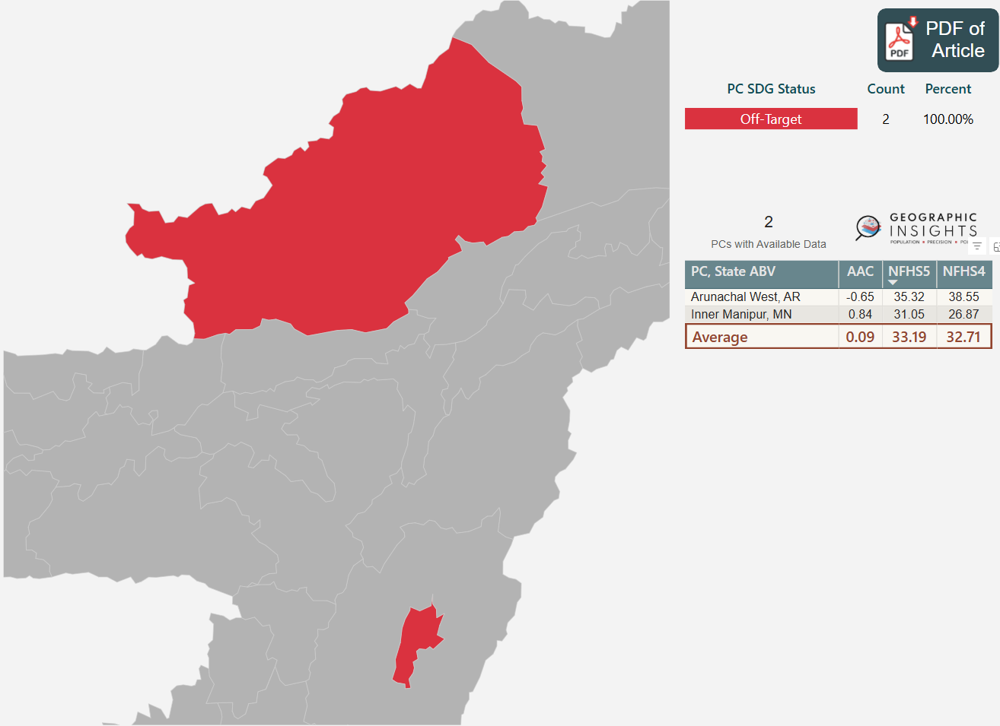
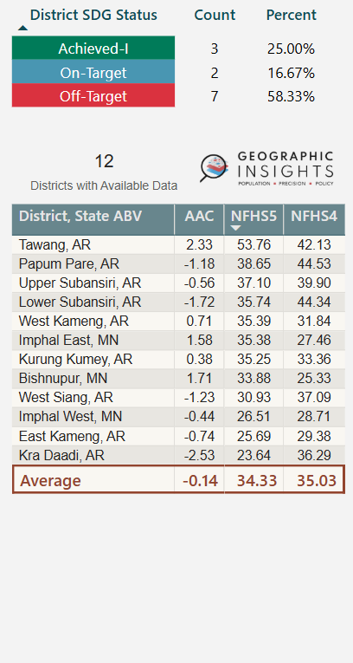
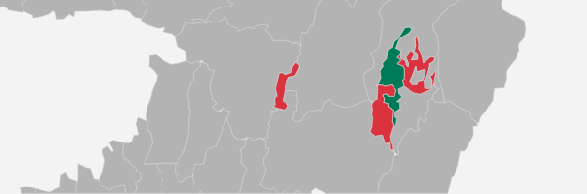
Anaemia (Women)
For Arunachal West constituency to reach on-target, women’s health belonging to Upper Subansiri, Kurung Kumey, West Kameng & Tawang regions must be of top-priority.
It’s high time for Inner Manipal constituency to implement refined policies in Imphal East & Bishnupur regions to regulate anaemia in women.
Administrative Lens
Political Lens
Upper Subansiri
West Siang
Kra Daadi
Arunachal West
Kurung Kumey
East Kameng
Tawang
Lower Subansiri
West Kameng
Papum Pare
Imphal West
Imphal East
Inner Manipur
Bishnupur

Slide 11

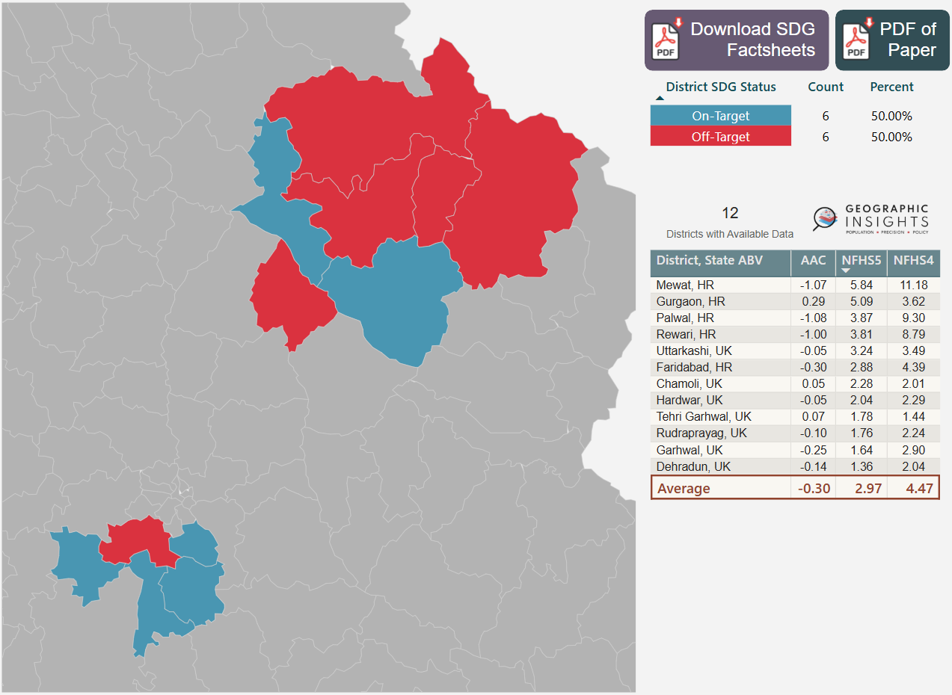
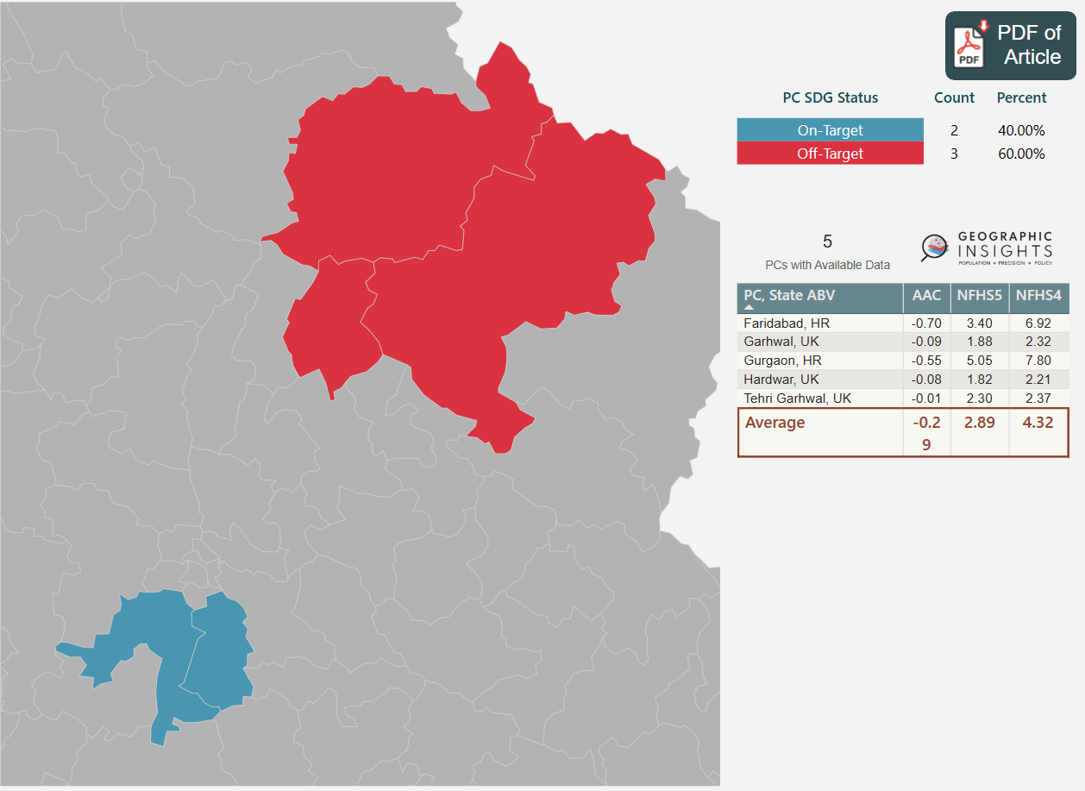
Teenage Pregnancy
(15 to 19)
Gurgaon constituency is on-target, but focus has to continue on teenager’s safety and security within Gurgaon district.
Both Garhwal & Tehri Garhwal constituencies look unsafe for teenagers, whereas Dehradun & Garhwal districts are on-target.
Administrative Lens
Political Lens
Uttarakashi
Tehri Garhwal
Dehradun
Chamoli
Rudraprayag
Garhwal
Haridwar
Garhwal
Haridwar
Tehri Garhwal
Gurgaon
Faridabad
Gurgaon
Faridabad
Rewari
Palwal
Mewat

Slide 12
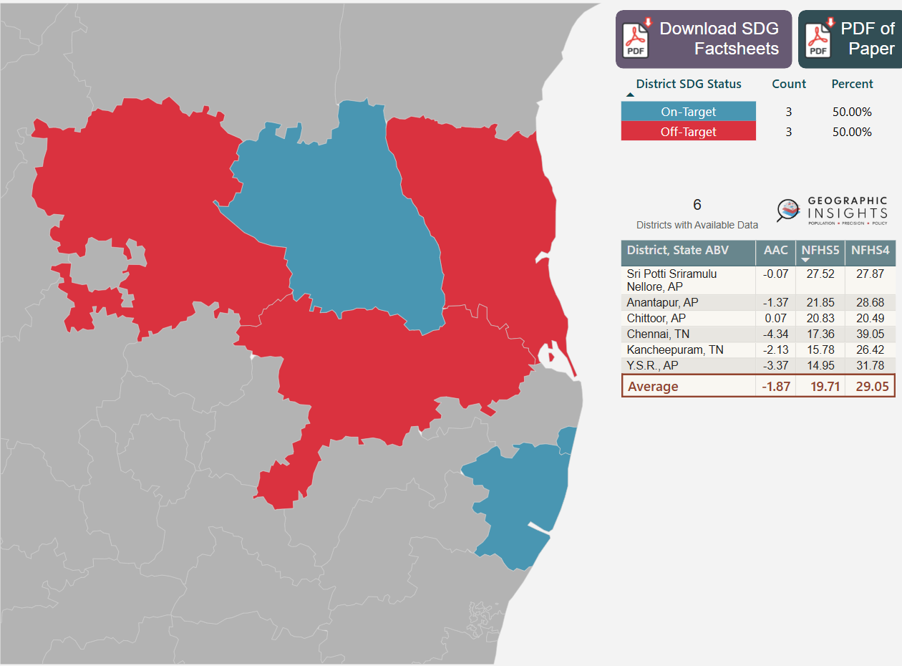
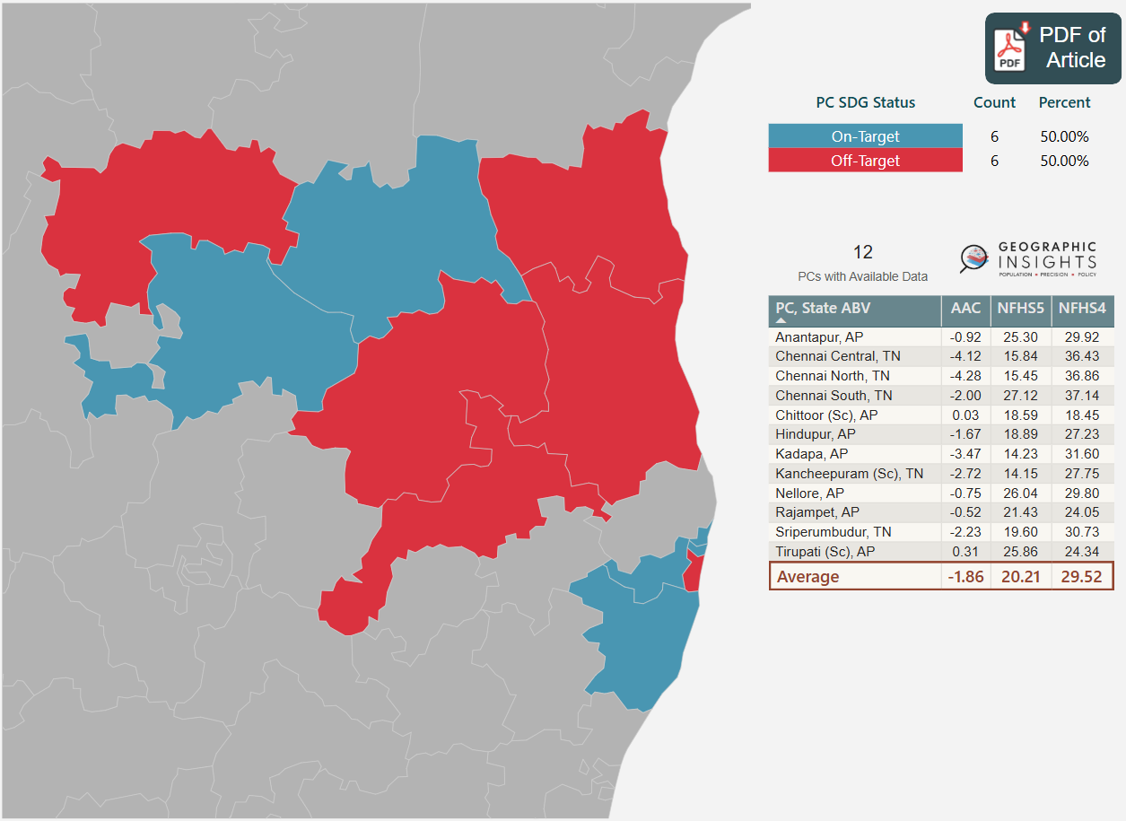
Tobacco Use (Men)
Chennai South constituency needs immediate attention as it can impact the progress in neighbouring regions like Kancheepuram, Chennai North & Central and Seriperumbudur.
Anantapur, Nellore & Rajampet constituencies have barely showed any progress since 2016. On the other hand, Tirupathi & Chittor constituencies show symptoms of worsening their off-target status. A series of awareness campaigns during ‘World No Tobacco Day’ may mitigate the risk.
Administrative Lens
Political Lens
Anantapur
YSR
Nellore
Anantapur
Kadapa
Nellore
Tirupati(Sc)
Hindupur
Rajampet
Chittoor
Chennai North
Chennai
Chittoor
Sriperumbudur
Kancheepuram
Chennai Central
Kancheepuram (Sc)
Chennai South

Slide 13

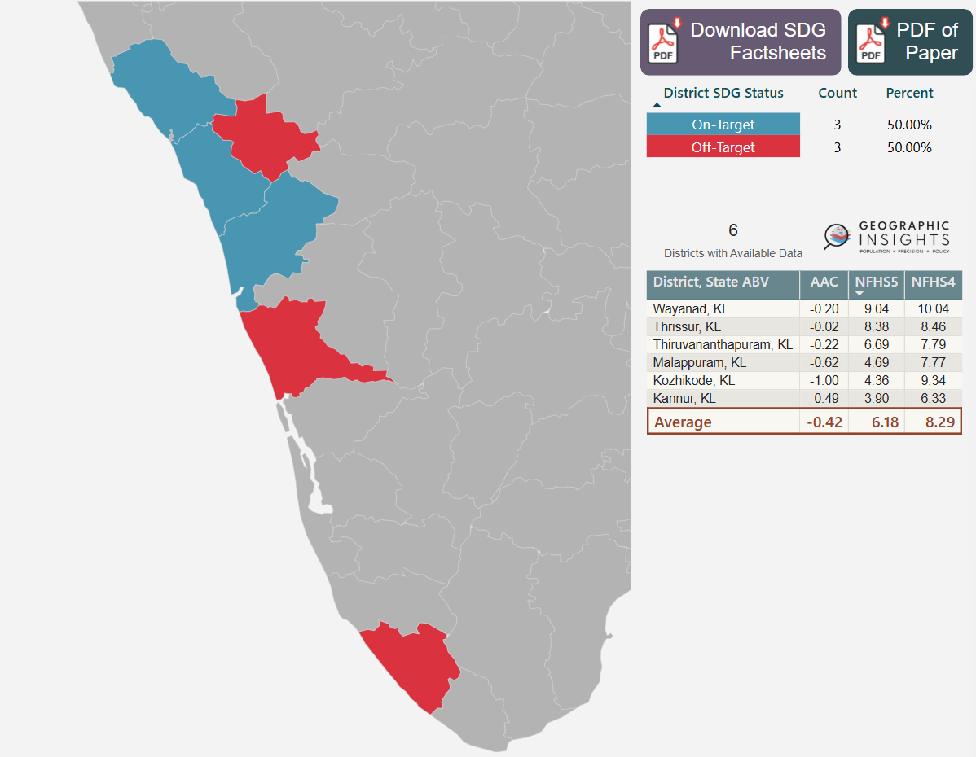
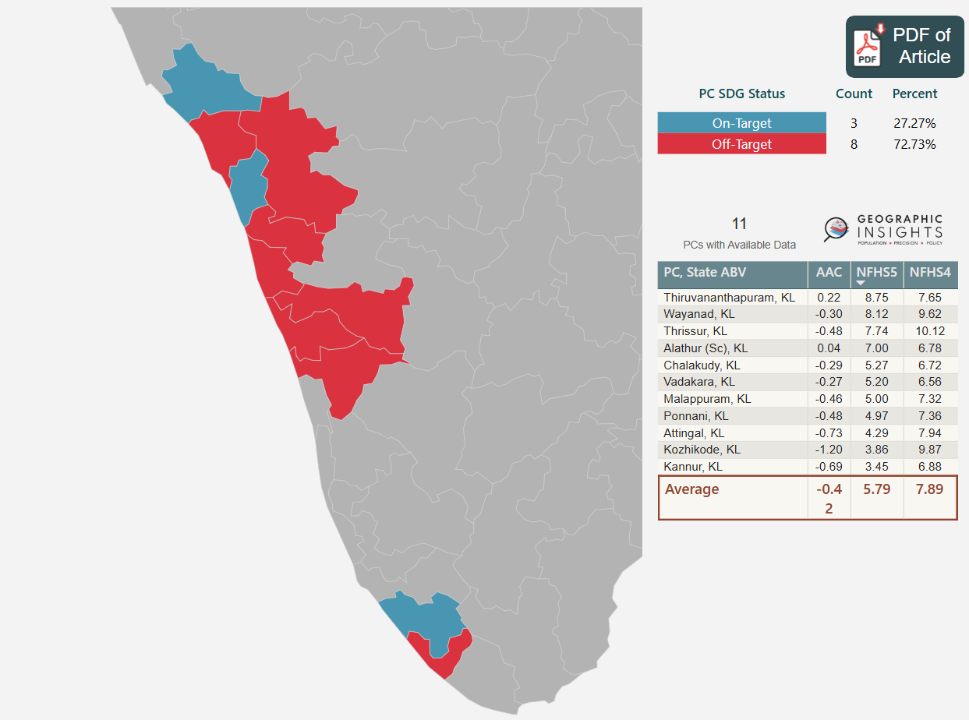
Partner Violence (Physical or Sexual)
Thiruvananthapuram constituency should set an example for rest of the state by bringing down partner violence.
Kannur, Attingal & Kozhikode constituencies showcase increased sensitivity towards women.
Administrative
Political
Kannur
Wayanad
Kannur
Vadakara
Kozhikode
Wayanad
Kozhikode
Malappuram
Malappuram
Ponnani
Alathur (Sc)
Thrissur
Thrissur
Chalakudy
Attingal
Thiruvananthapuram
Thiruvananthapuram

Slide 14
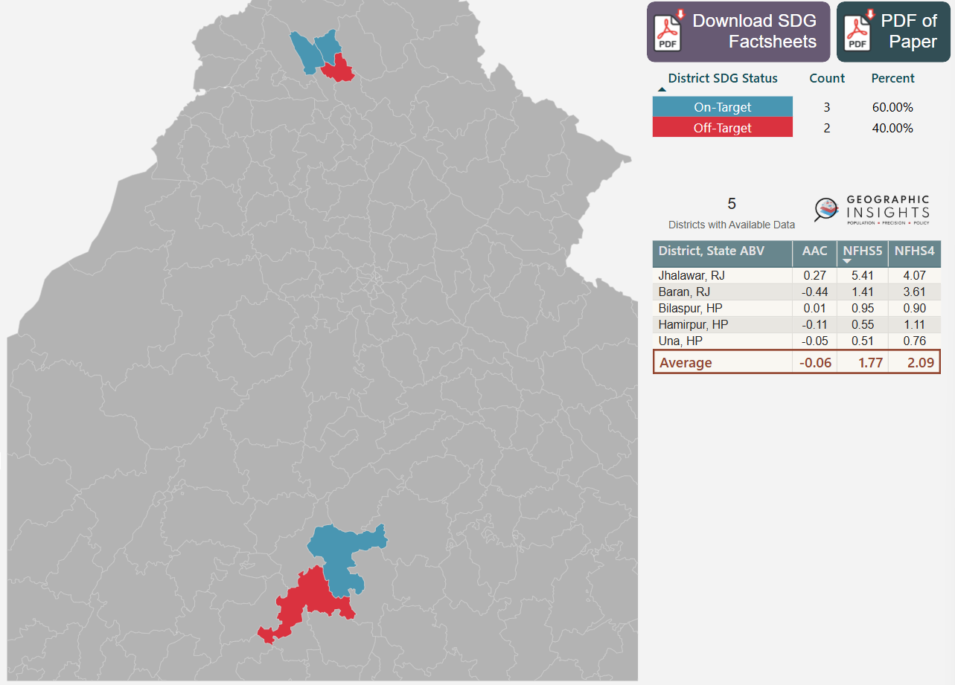
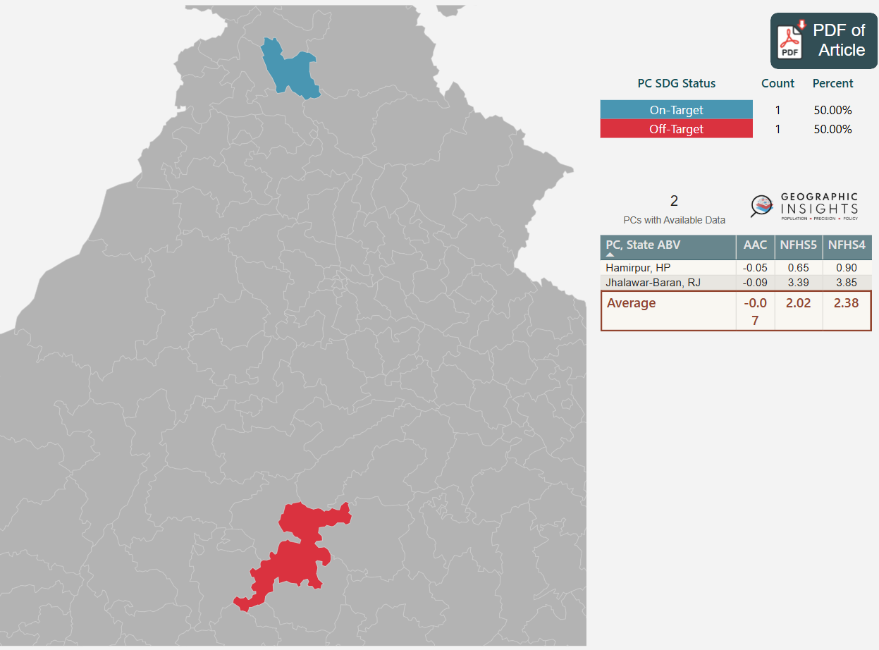
Child Marriage Girl (< 15)
Child Marriage is still prevalent in Bilaspur and needs prompt action.
Jhalawar-Baran constituency need to shift his focal point to Jhalawar region to prevent child marriage.
Hamirpur
Administrative
Political
Una
Bilaspur
Hamirpur
Baran
Jhalawar-Baran
Jhalawar

Slide 15

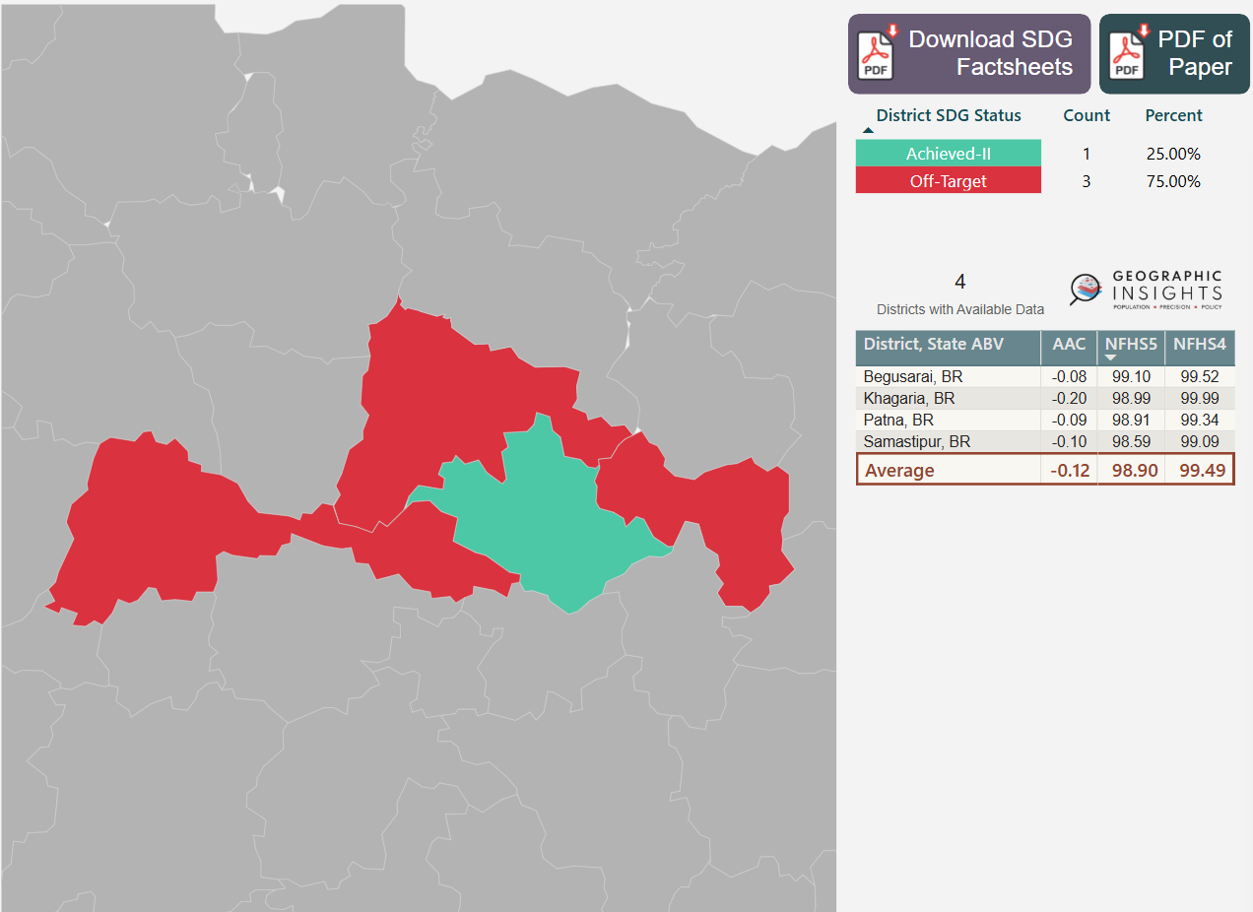
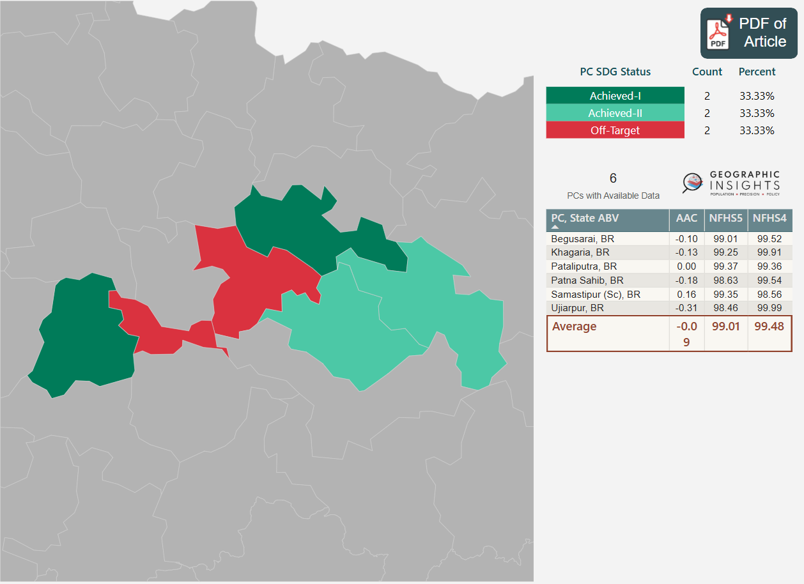
Improved Water
Water quality in Patna Sahib and Ujiarpur constituencies has degraded - needs immediate attention.
Begusarai & Khagaria constituencies have probability of shifting off-target if water quality isn’t tracked & maintained.
Administrative
Political
Samastipur
Samastipur
Ujiarpur
Khagaria
Khagaria
Pataliputra
Patna Sahib
Begusarai
Patna
Begusarai

Slide 16

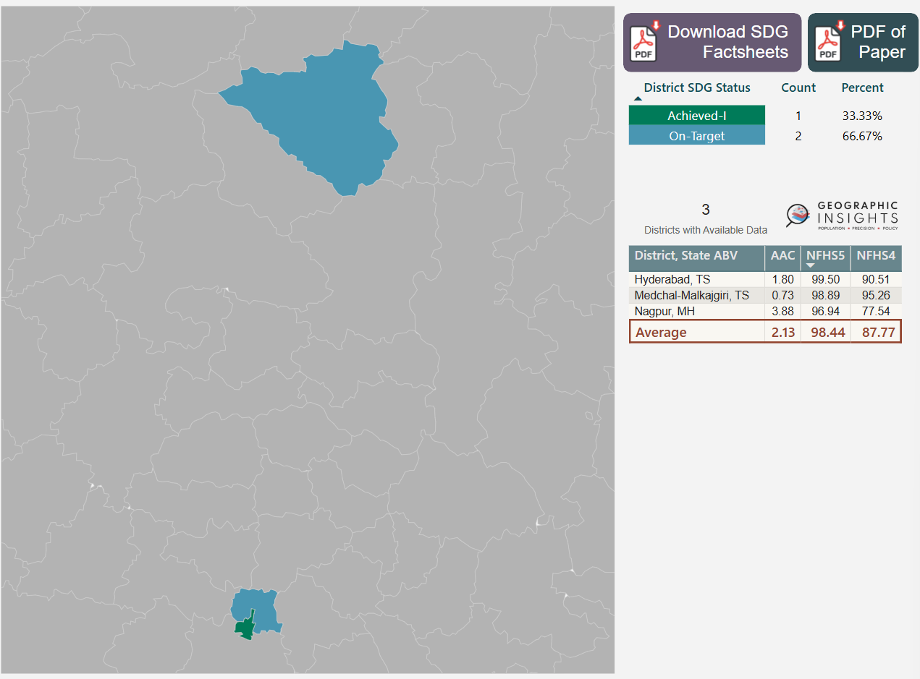
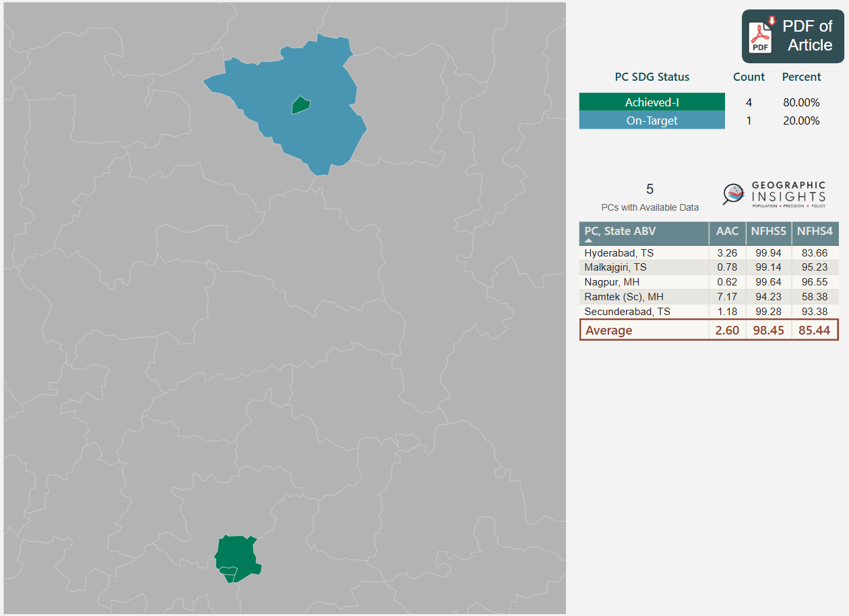
Clean Fuel for Cooking
Nagpur constituency is in a good position with achieved target, whereas Ramtek is on-target.
Hyderabad, Secunderabad and Malkajgiri regions are also on Achieved-I status.
Administrative
Political
Nagpur
Nagpur
Ramtek
Medchal-Malkajgiri
Malkajgiri
Secunderabad
Hyderabad
Hyderabad

Slide 17

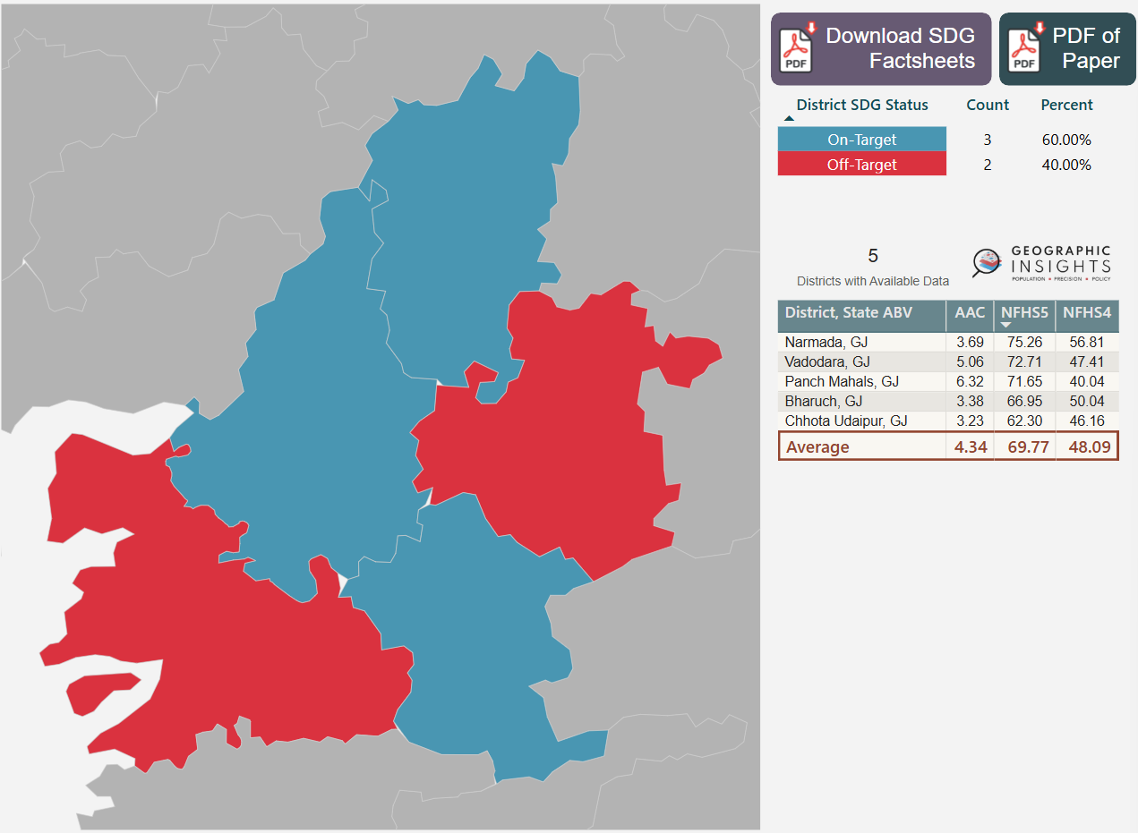
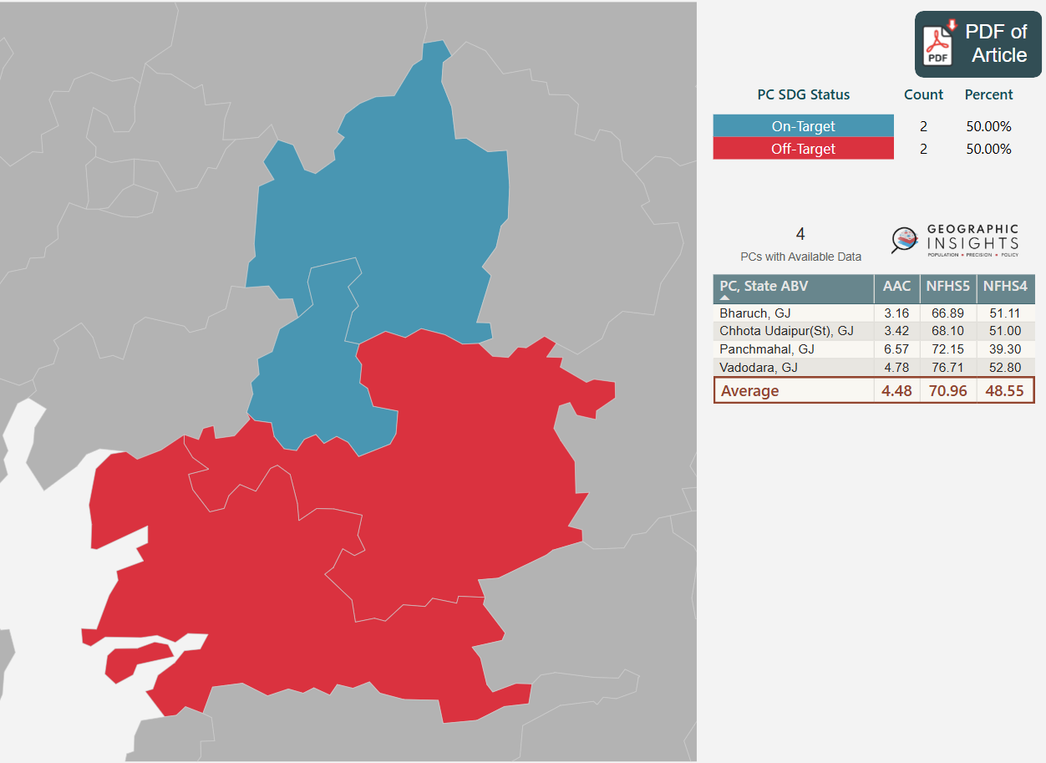
Bank Account for Women
Northern part of Chhota Udaipur and Western part of Bharuch constituency need serious attention to help women with identification & bank accounts.
Panchmahal & Vadodara continue to be on-target.
Administrative
Political
Panch Mahals
Panchmahal
Chhota Udaipur
Vadodara
Vadodara
Chhota Udaipur
Bharuch
Narmada
Bharuch

Slide 18

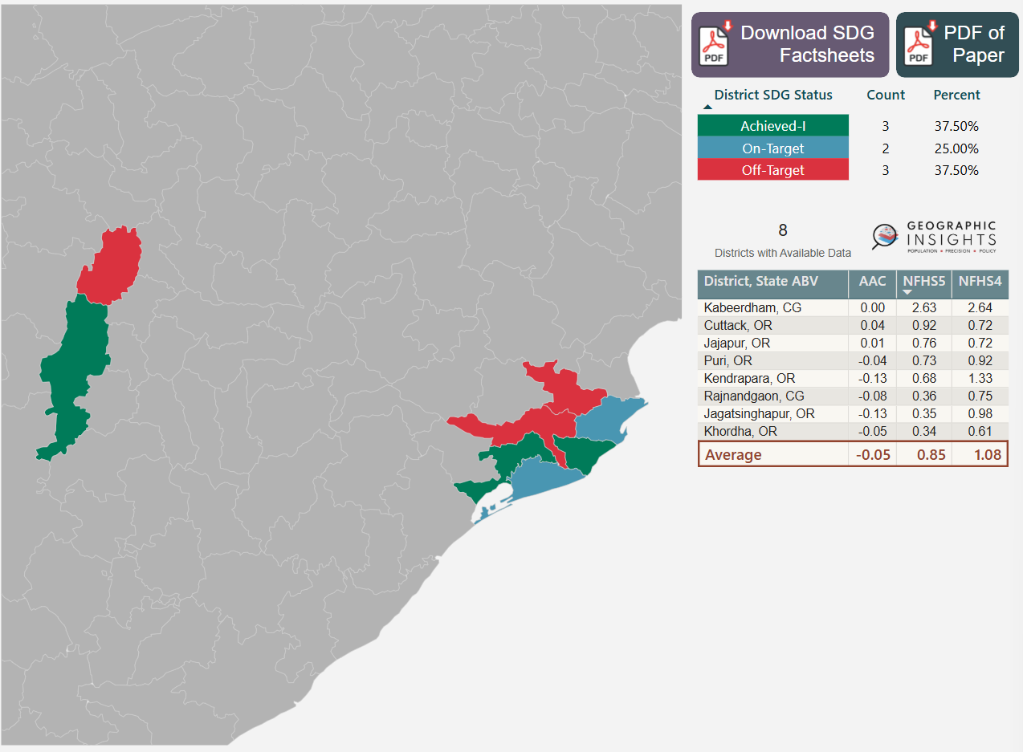
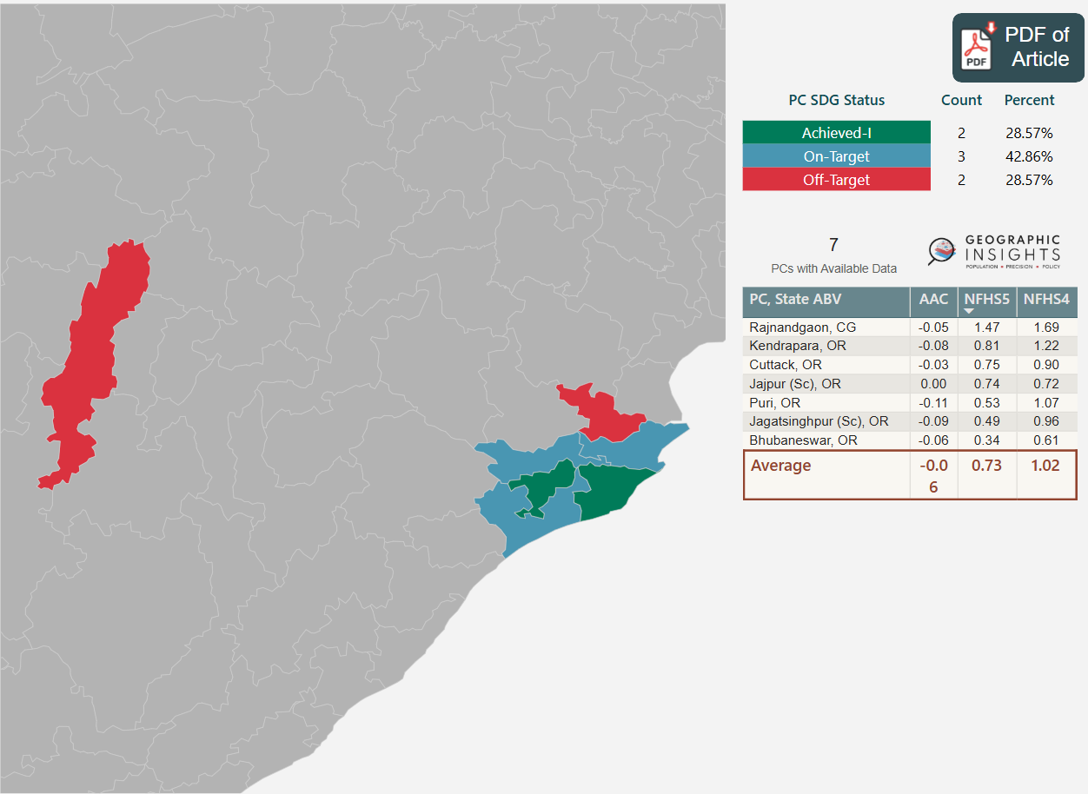
Teenage Sexual Violence
Kabeerdham has to be the focal point in Rajnandgaon constituency.
Jajpur (Sc) is neglected & need policy amendments for teenagers to feel safer.
Cuttack constituency which surrounds most of the Bhubaneswar is on-target now as there has been great progress in Khordha region.
Administrative
Political
Kabeerdham
Rajnandgaon
Jajapur
Jajpur (Sc)
Rajnandgaon
Cuttack
Kendrapura
Cuttack
Kendrapura
Bhubaneshwar
Khordha
Jagatsinghpur
Puri
Jagatsinghpur (Sc)
Puri

Slide 19

Conclusion
This research aims to empower both Members of Parliament (MPs) and their constituents by making SDG indicators visible at the Parliamentary Constituency (PC) level for better accountability and governance.
The discordance in the populations and geographic boundaries that are served by districts and constituencies and the inefficiencies they bring to development governance make a compelling case for establishing a national commission to systematically explore and develop a strategy for harmonizing these two critical policy units.
In addition, there is a delimitation scheduled for reconstituting the number and geometry of parliamentary and assembly constituencies in 2026 and it would be timely to consider possibilities of establishing this commission.
Recent years have seen India’s elected officials engage publicly and more consistently in articulating and shaping policy agendas. Creating a robust constituency-level data surveillance and monitoring system on the health and well-being of their population can bring the necessary political synergy and accountability needed to accomplish the SDGs.

Slide 20
Thank you
References:
Kim R, Swaminathan A, Kumar R, et al. Estimating the burden of child malnutrition across parliamentary constituencies in India: a methodological comparison. 2019;7:100375. https://doi.org/10.1016/j.ssmph.2019.100375. Supplementary Material: https://ars.els-cdn.com/content/image/1-s2.0-S2352827318303732-mmc1.docx
Community Created Maps of India. https://projects.datameet.org/maps/
Empirical Evidence for Parliamentary Constituency Estimates. https://geographicinsights.iq.harvard.edu/files/geographicinsights2/files/robust_parliamentary_constituency_estimates_geographic_data_science_approaches.pdf
Subramanian SV, Ambade M, Kumar A, et al. Progress on sustainable development goal indicators in 707 districts of India: a quantitative mid-line assessment using the National Family Health Surveys, 2016 and 2021. https://doi.org/10.1016/j.lansea.2023.100155. Geographic Insights using Power BI – district level. https://geographicinsights.iq.harvard.edu/District-SDG-Progress
Subramanian SV, Amar Patnaik, Rockli Kim, et al. Call for action: presenting constituency-level data on population, health and socioeconomic wellbeing related to 2030 Sustainable Development Goals for India. https://doi.org/10.1016/j.lansea.2024.100358. Geographic Insights using Power BI – constituency level. https://geographicinsights.iq.harvard.edu/PC-SDG-Progress
- Budha Sree Mandapaka

